Slide 1
Alnes Studio
Welcome to our presentation

Slide 2
Content
What is Alnes?
How was Alnes Studio founded?
Who founded Alnes Studio?
Who are we?
What is our aim?
What is our mission?
What is our perspective on design?
What are the features we look for in our products?
Designs
Softwares
Finish

Slide 3
What is Alnes?
It is a word formed by the abbreviation of the name ALneSs,
which our founder used when dealing with Hack,
it was formed by the combination of the words "All" and "Ness".

Slide 4
How was Alnes Studio founded?
Alnes Studio was formed when our founder decided to continue by establishing his own group,
as the management of the teams he participated in was not good at all.

Slide 5
Who founded Alnes Studio?
Founded by an entrepreneur who has been working for software more than 10 hours a day since 2020.

Slide 6
Who are we?
We are a community that works for our missions and goals.
We are constantly working to improve our quality

Slide 7
What is our aim?
Our aim is to maximize the efficiency of softwares with our technologies.

Slide 8
What is our mission?
Our mission is produce the most efficient

Slide 9
What is our perspective on design?
We believe that it is most important to produce long-lasting designs.

Slide 10
What are the features we look for in our products?
We pay the most attention to "what the user demands" in our products.

Slide 11

Design
Our logo is one of our best designs. It has many meanings.

Slide 12
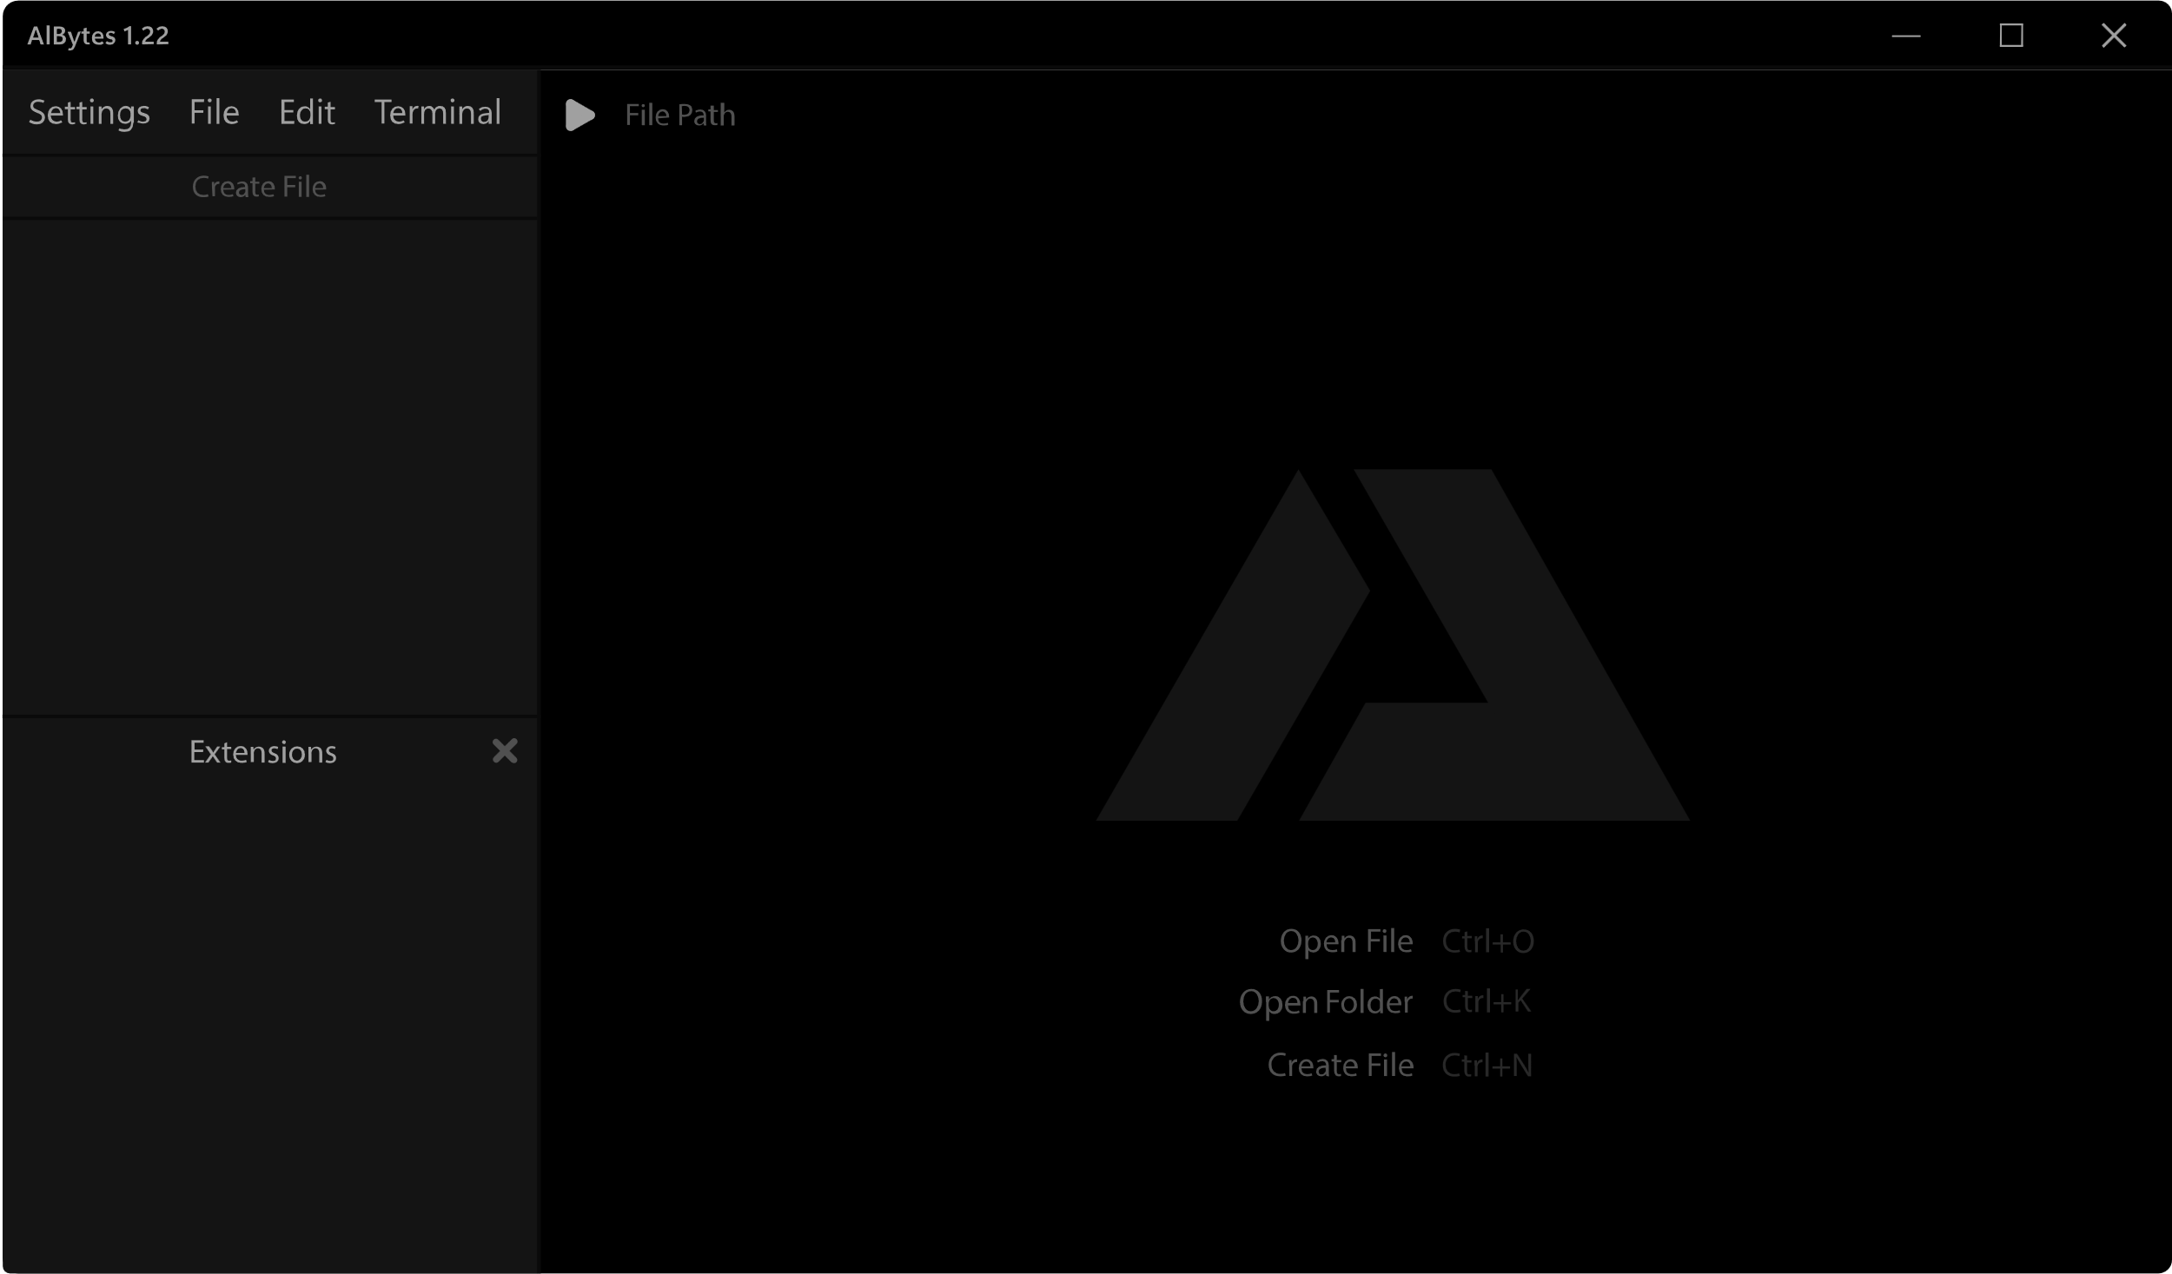
Software
We are developing many projects in your mirror, our currently published application is AlBytes.

Slide 13
Finish
Thanks for listening!

